Slide 1

ONLINE FOOD DELIVERY SYSTEM
Under the guidance of
Pooja Mehta
Submitted By
Yamini Keerthi Vadlapatla
Maitrai Tumulury
ShivaKrishna Kalyadapu
Sachin Gupta
Bharath Marapaka

Slide 2
INTRODUCTION
Online food ordering is the process of ordering food, for delivery from a website or other application. The product can be either ready-to-eat food.
Despite the lack of personal interaction, the software provides online customers with the same features someone visiting the restaurant or ordering on the phone would have. This includes access to the entire menu with full customization.

Slide 3
PROJECT OBJECTIVE
To evaluate the way of interaction with customers.
To develop a restaurant ordering system with web application based on the client server application.
To determine the factors that influence customer when ordering food online.

Slide 4
TECHNOLOGIES USED
Spring Boot
Postman
MySQL
Maven

Slide 5
REQUIRED SPECIFICATIONS
Hardware Configuration | Software Configuration
Operating System : Windows 10 | Software IDE : Spring Boot
Hard Disk : 1 Tb | Language : Java
RAM : 8gb | Back End : MySQL Server , Postman

Slide 6
PROPOSED SYSTEM
This system is a bunch of benefits from various point of views. As this online application enables the end users to register to the system online, select the food items of their choice from the menu list, and order food online. And also user able to add, update and delete food items in cart.
System will store the information about new entry of food item, maintain quantity record, it will keep the record of the customer.

Slide 7
SPRING ANNOTATIONS
@Controller : The @Controller annotation indicates that a particular class serves the role of a controller. Spring Controller annotation is typically used in combination with annotated handler methods based on the @RequestMapping annotation.
@Autowired : The @Autowired annotation provides more fine-grained control over where and how autowiring should be accomplished.
@RequestMapping : @RequestMapping is one of the most common annotation used in Spring Web applications. This annotation maps HTTP requests to handler methods of MVC and REST controllers.
@Entity : The @Entity annotation specifies that the class is an entity and is mapped to a database table.

Slide 8
@Table : The @Table annotation is used to create a table in database.
@JoinColumn : @JoinColumn is used to specify a column for joining an entity association or element collection.
@PutMapping : @PutMapping is used for update the records.
@PostMapping : @PostMapping is used to create a resource.
@GetMapping : @GetMapping is used to read all the inserted records.
@DeleteMapping : @DeleteMapping is used to delete the records.
@Param : @param is used to denote a description of the parameter a method can receive.
@PathVariable : The @PathVariable annotation is used to extract the value from the URL.

Slide 9
@RequestParam : @RequestParam annotation is used to read the form data and bind it automatically to the parameter present in the provided method.
@RequestBody : The @RequestBody annotation allows us to retrieve the request's body.
@OneToOne Mapping : The @OneToOne JPA annotation is used to map the source entity with the target entity. Hibernate maps the tables in your database to the Entity classes in your application
@OneToMany Mapping : One-to-Many relationship between table A and table B indicates that one row in table A links to many rows in table B, but one row in table B links to only one row in table A.
@ManyToOne Mapping : Many-to-One mapping means that many instances of this entity are mapped to one instance of another entity.

Slide 10
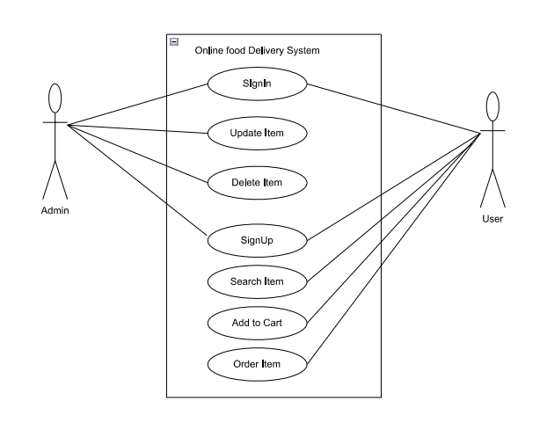
USECASE DIAGRAM

Slide 11
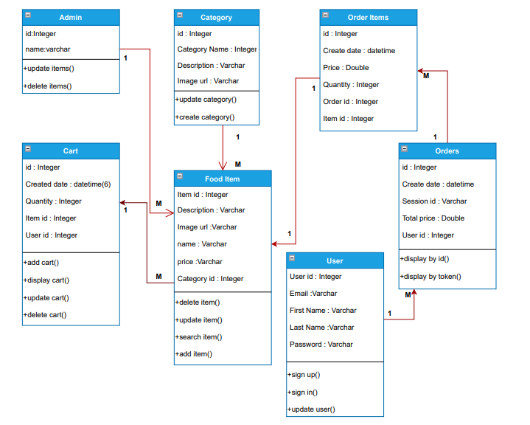
CLASS DIAGRAM

Slide 12
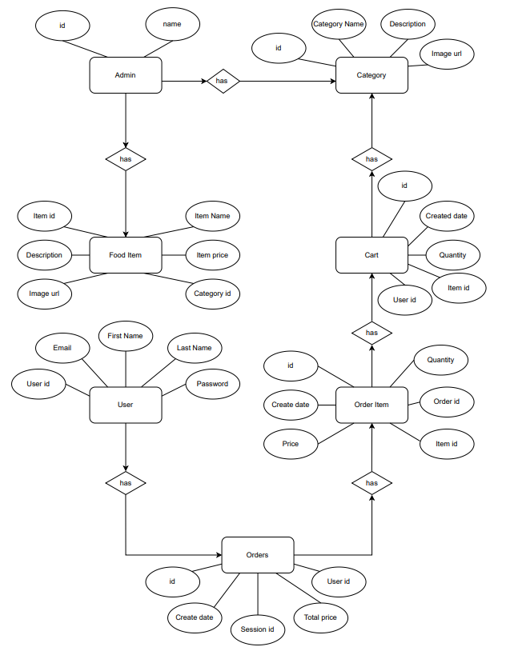
ER DIAGRAM

Slide 13
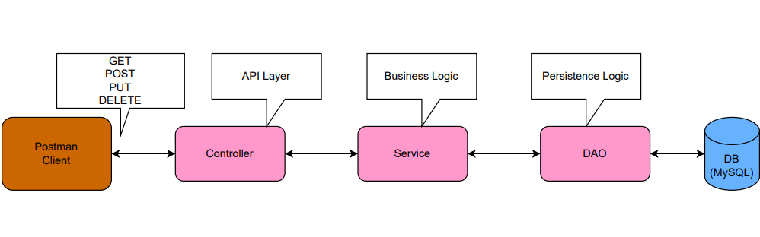
SYSTEM DIAGRAM

Slide 14
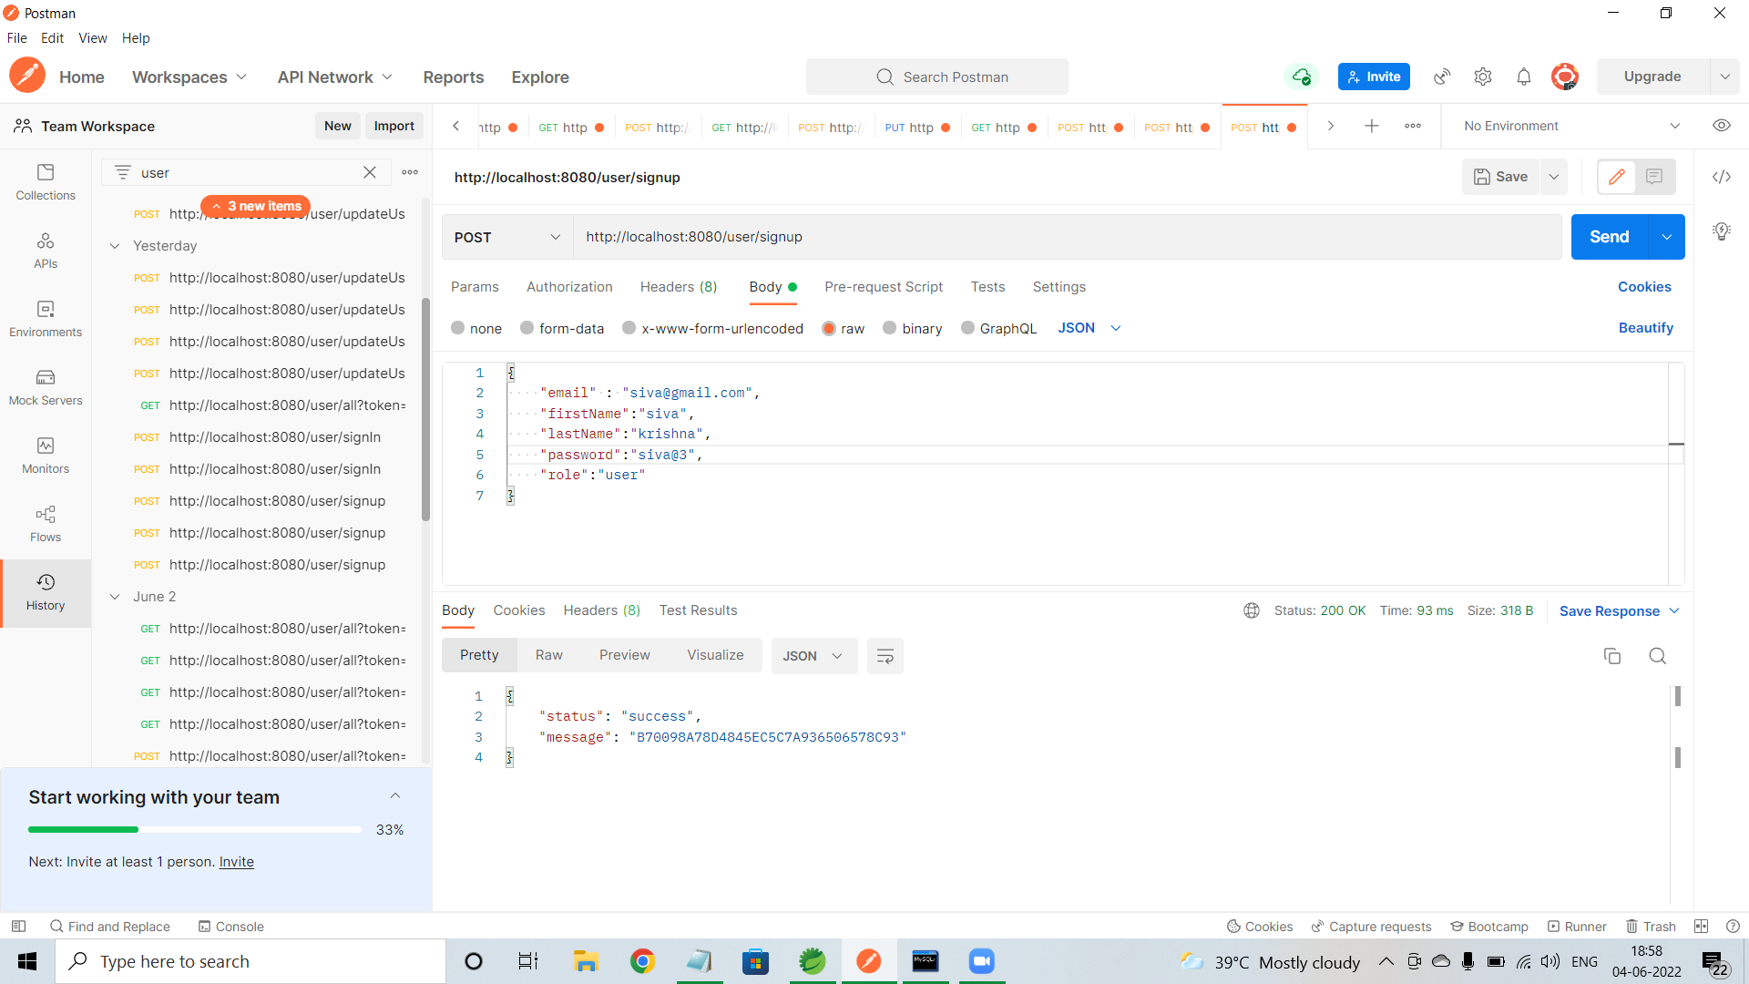
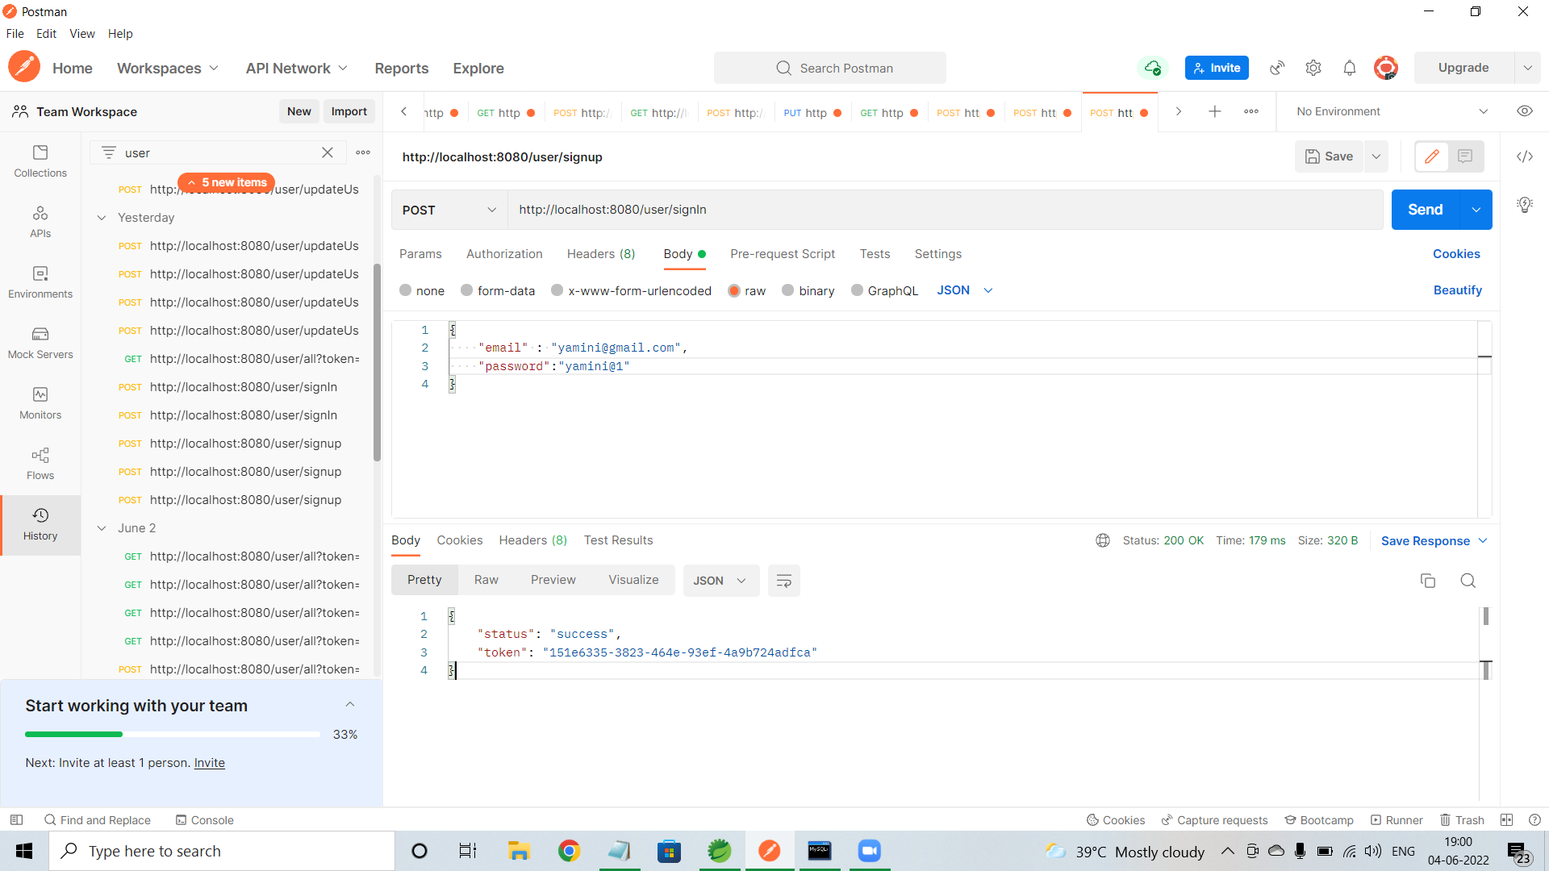
OUTPUT SCREENSHOTS
User/signup
User/signIn

Slide 15
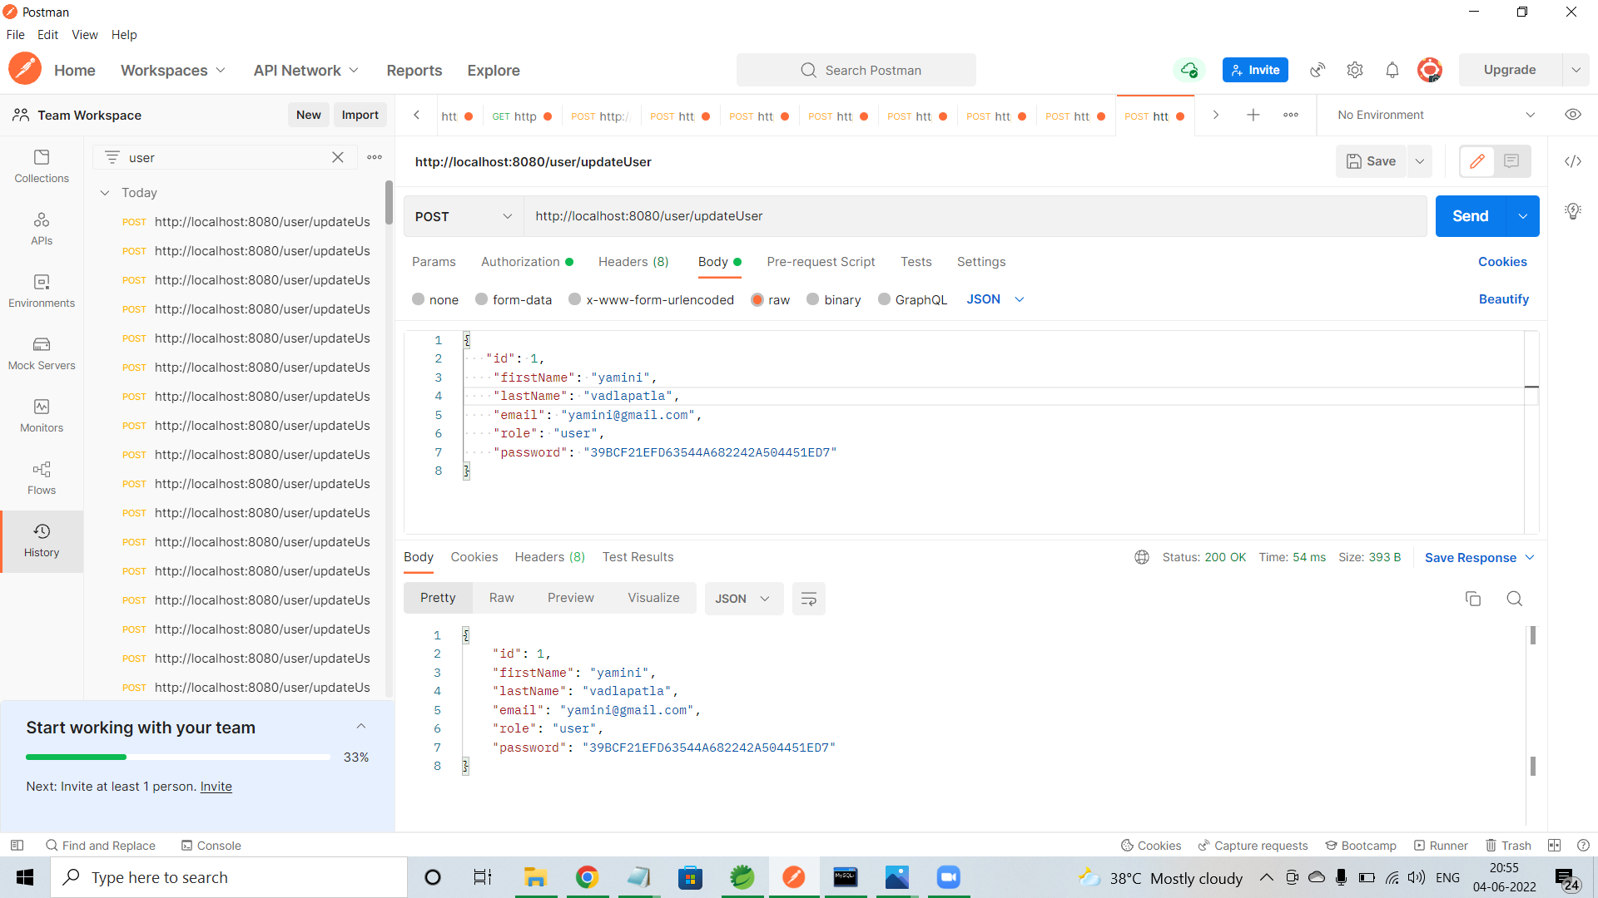
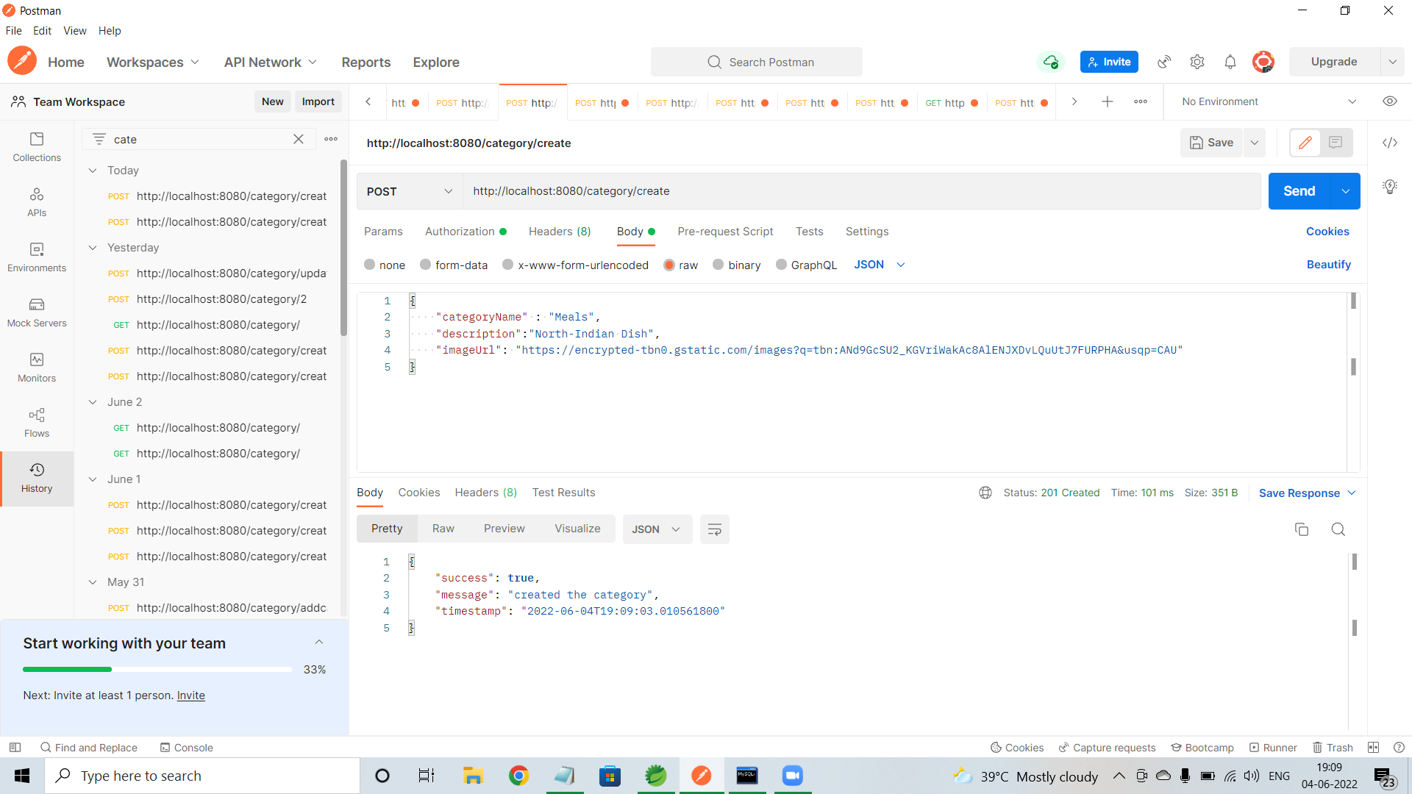
User/update
Category/create

Slide 16
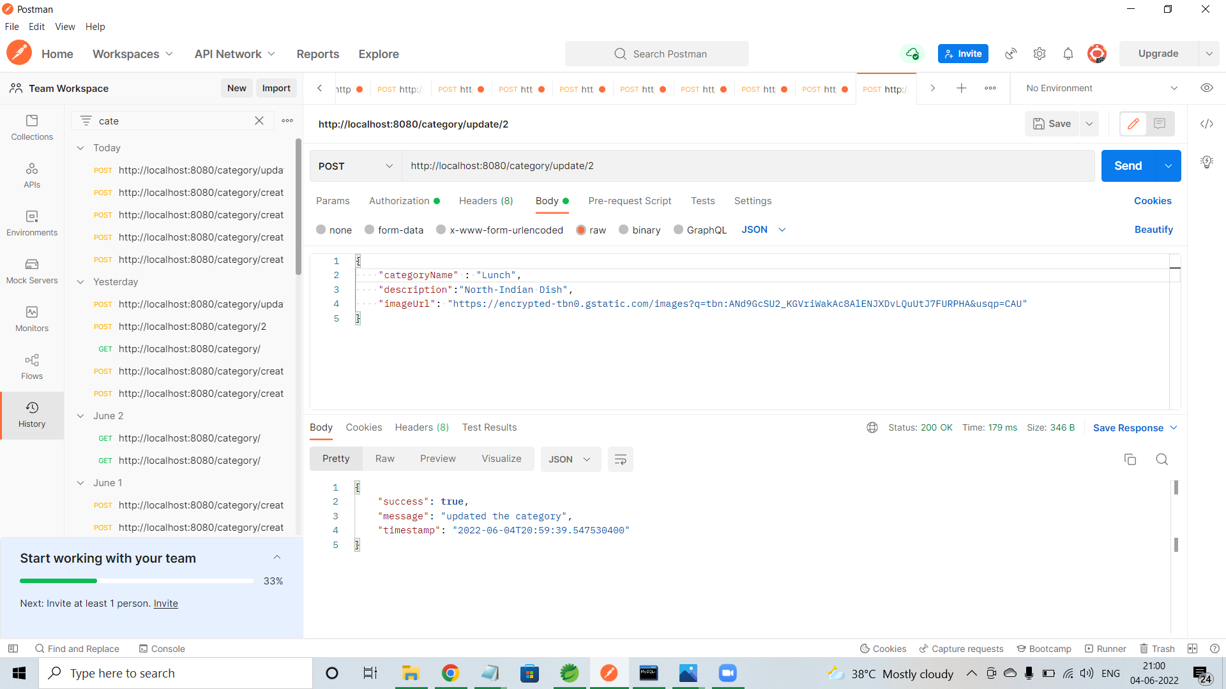
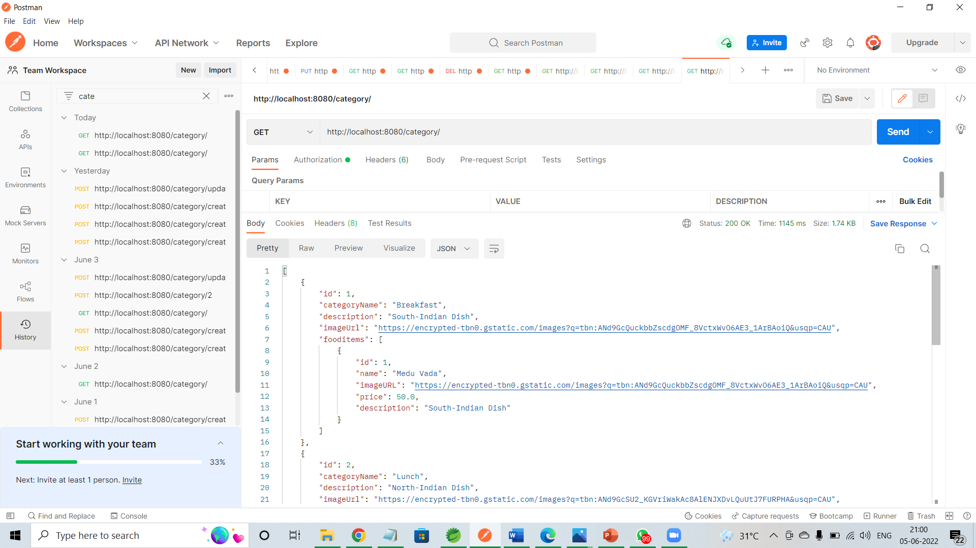
Category/update
Category/all

Slide 17
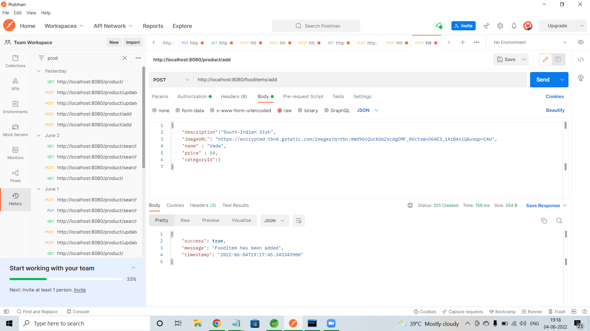
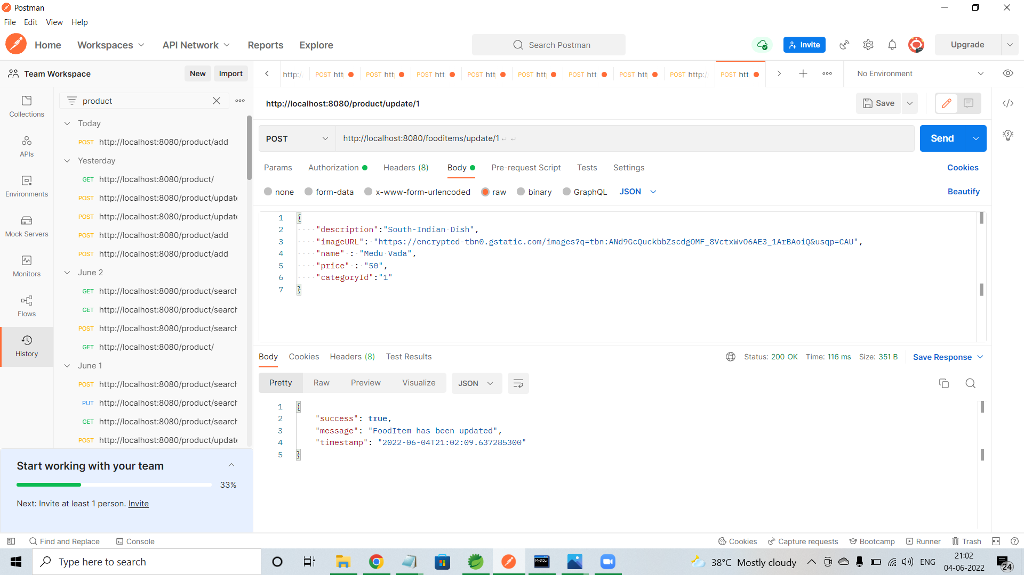
Fooditem/add
Food/update

Slide 18
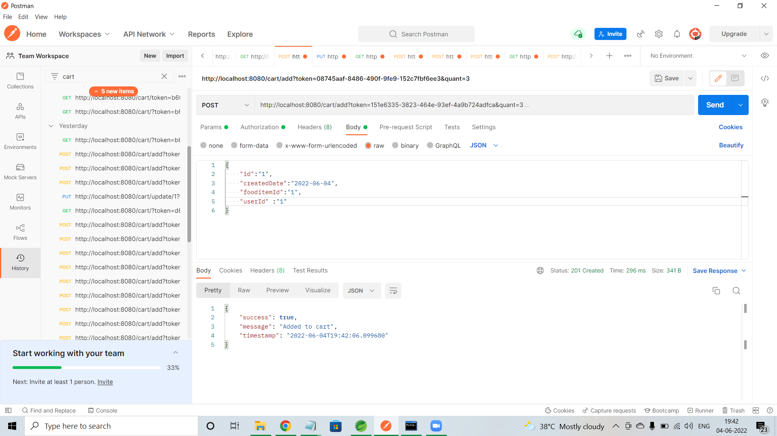
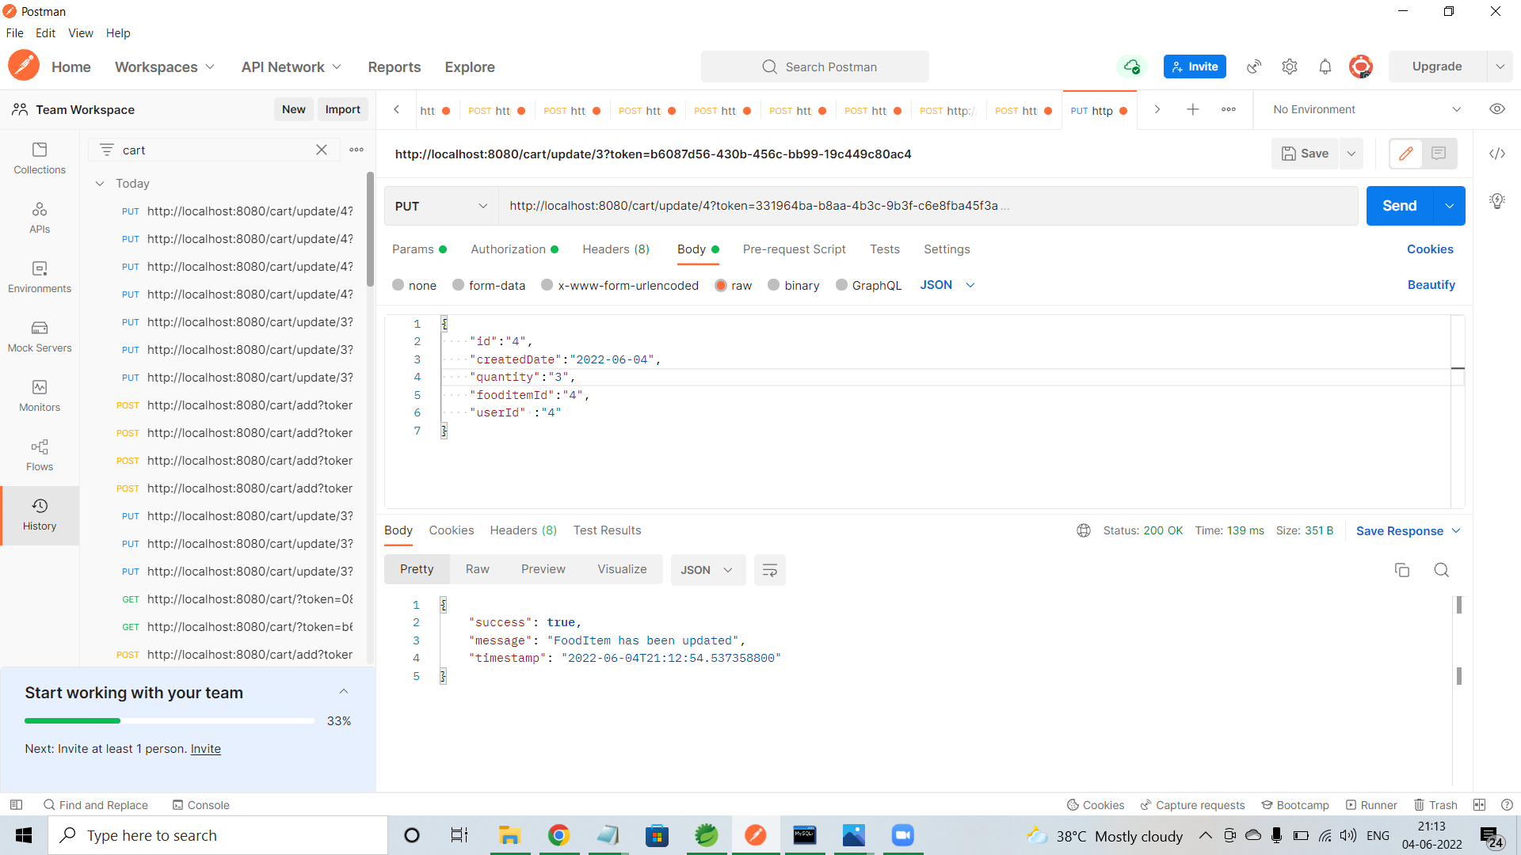
Cart/add
Cart/update

Slide 19
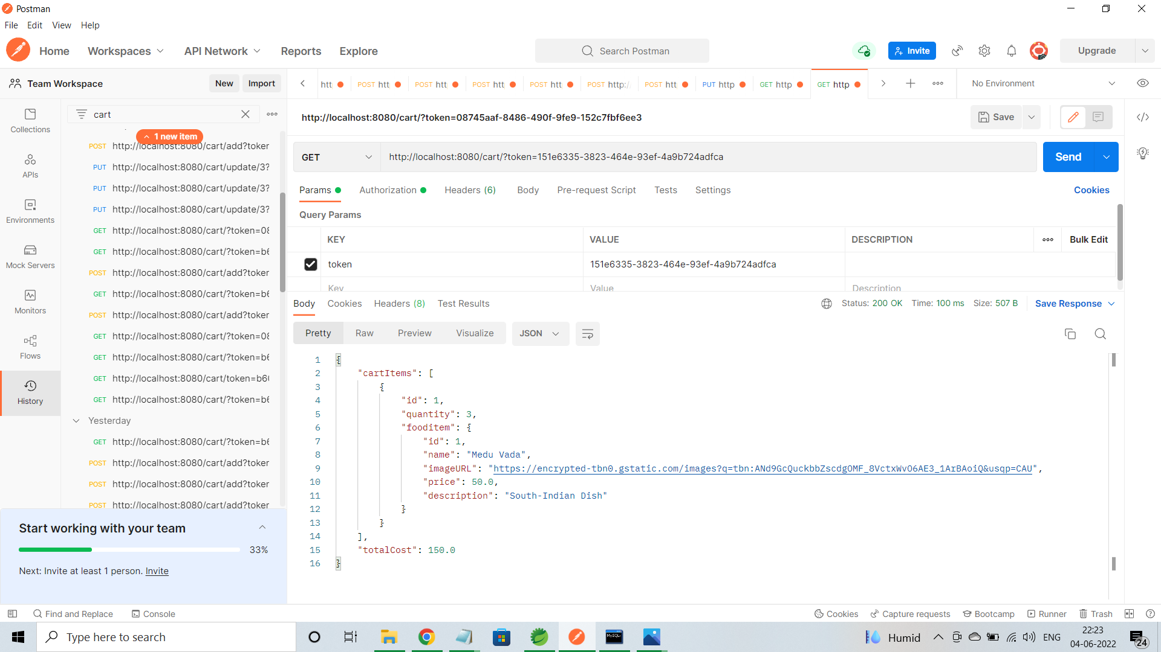
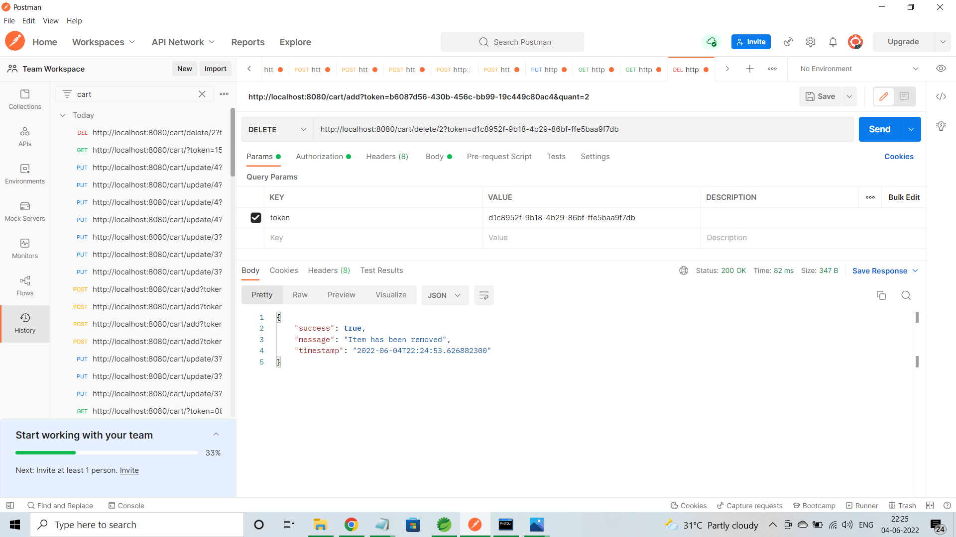
Cart/all
Cart/delete

Slide 20
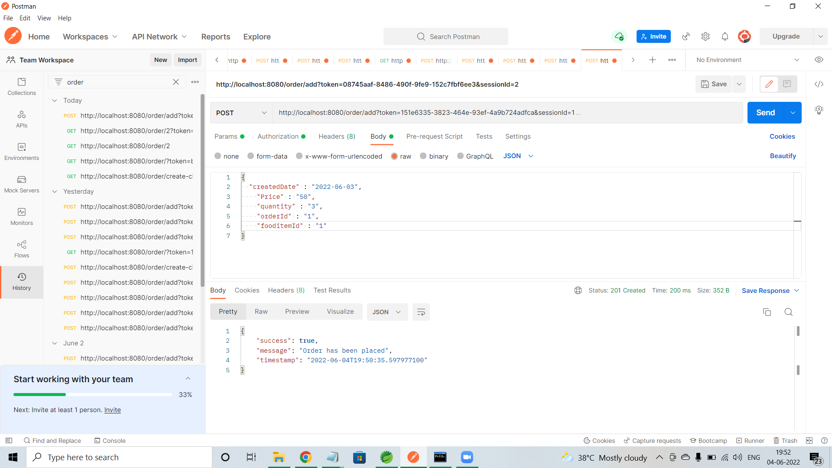
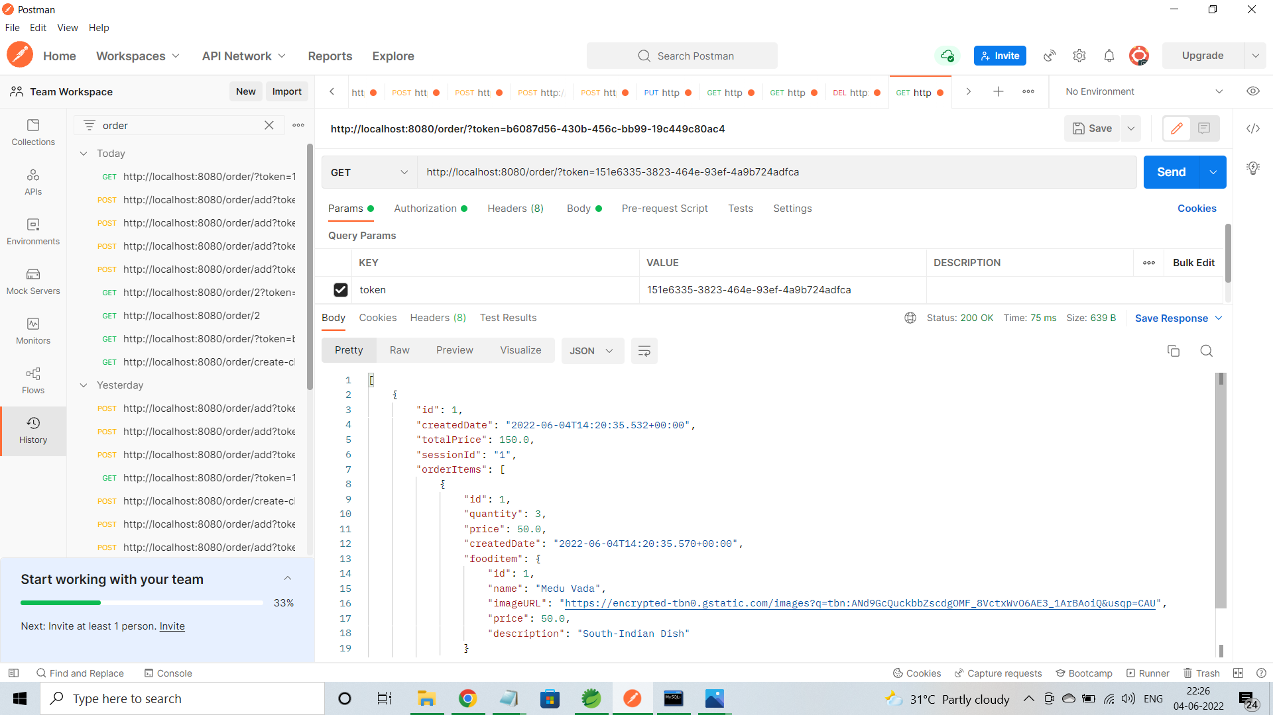
Order/add
Order/all

Slide 21
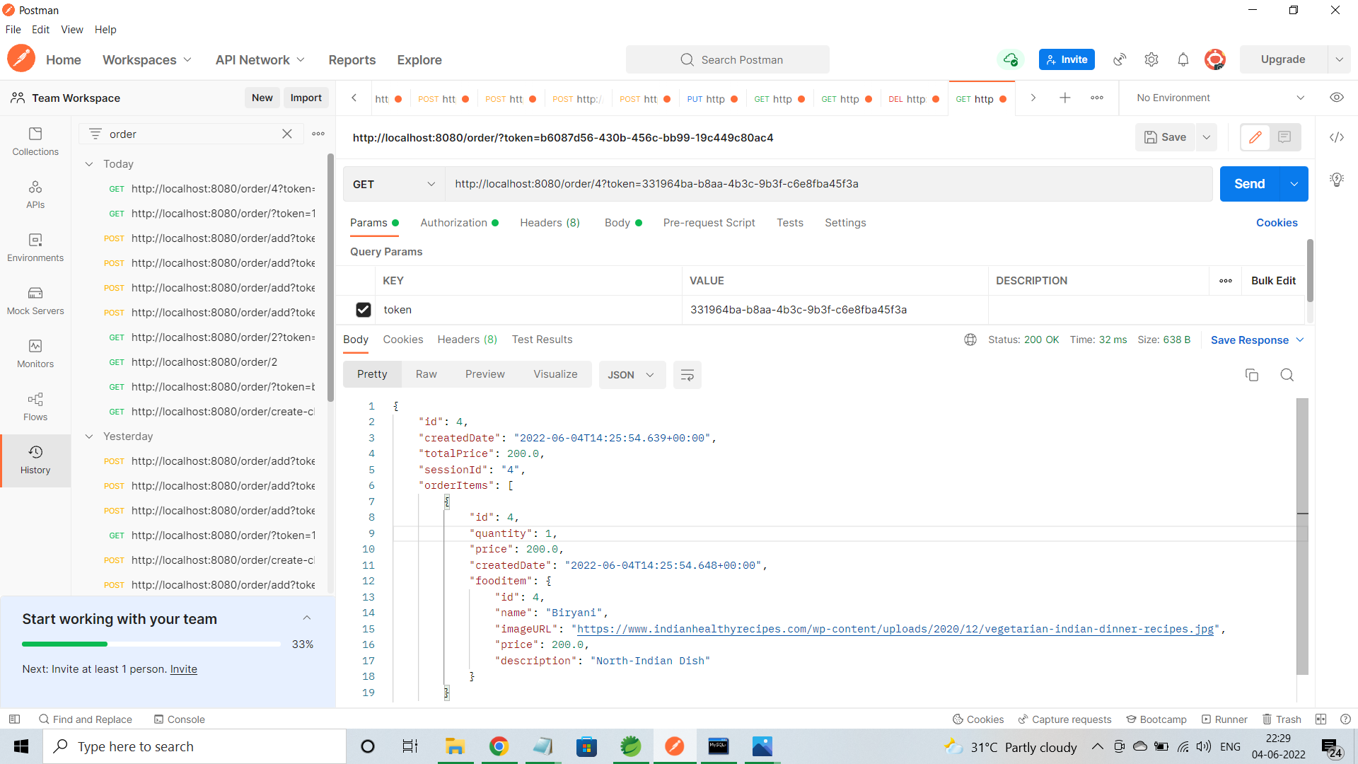
Order/all by id

Slide 22
ADVANTAGES
Clients can order whenever they want.
Makes the ordering process easier.
Customer’s satisfaction.
The convenience of mobile ordering.
No more waiting in long queues to place an order.
Discover New Items.

Slide 23
CONCLUSION
Online Food Ordering system is done to help and solve one of the important problems of customer. Because Large number of customer can use the internet and phone. Various issues related to Mess/Tiffin Service will be solved by these system. Thus, implementation of Online Food Ordering system is done to help and solve one of the important problems of customer. It helps customer in making order easily and gives information needed in making order to customer place.

Slide 24
THANK YOU

